Slide 1
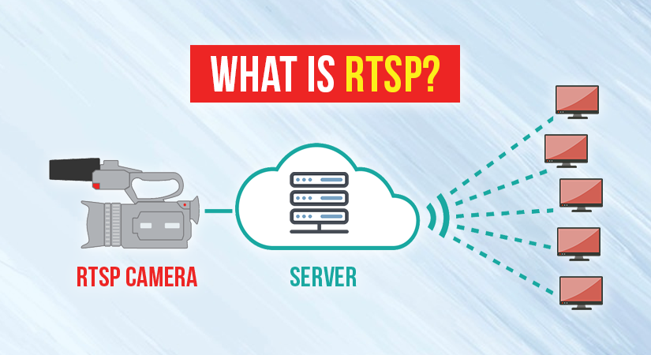
Notes:
Rtsp == real time streaming protocol

Slide 2
What is RTSP?
Application layer protocol for controlling multimedia streams
Not application data transmission protocol just a remote control protocol between client and server
Notes:
CONTROL!!!
Connection text based(commands/url) between client-server
Create session
Sends commands from client to server
Transfer real time data from multimedia (audio/video) to endpoint device

Slide 3
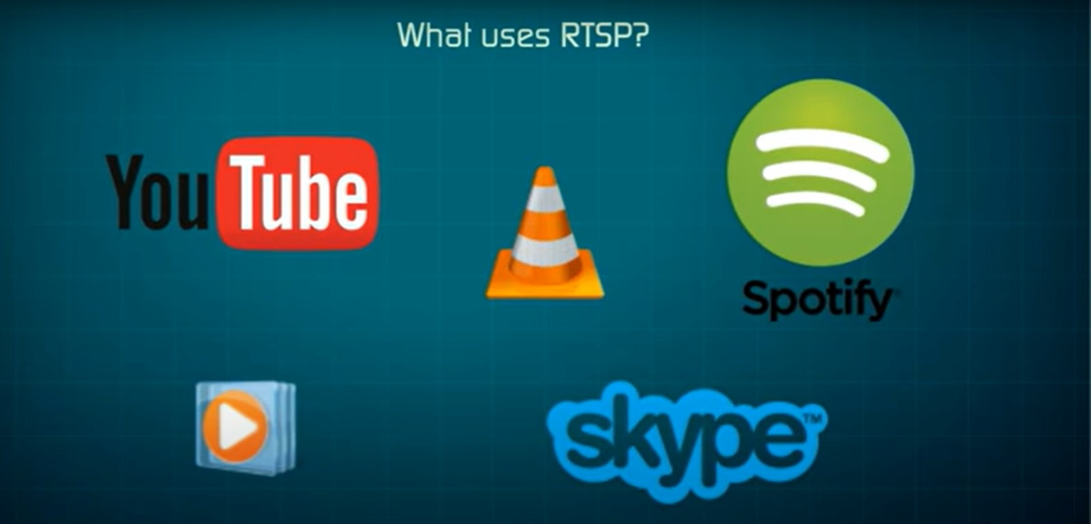

Slide 4
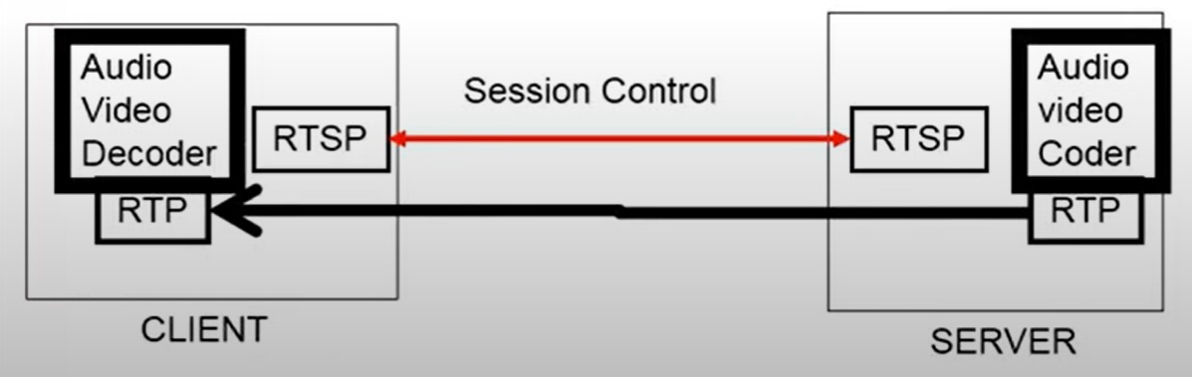
Notes:
Rtp == transport layer
Rtsp == application layer
Rtp transport the media from the server and put it in the client random access memory (ram)
Rtsp send commands and reply between client and server

Slide 5


How It Works?
Request Option
Accepted Request Types

Slide 6
Describe Request
Description of Media

Slide 7
Set Up
Transport Mechanism
Notes:
setup request: tell the server how to transport the media and which port to use
When done of this, the streaming protocol starts when the client tell the server to start sending the bitstream via transport mechanism specified already.

Slide 8
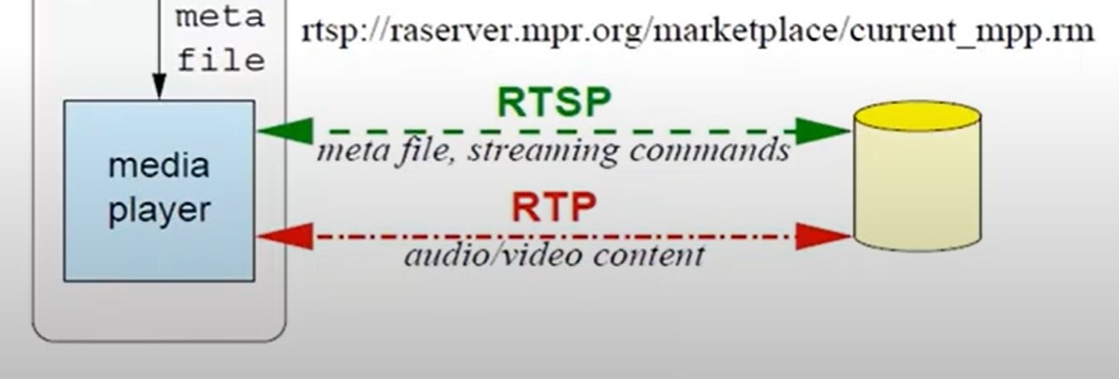
Key Components
Client
Sessions
Server
Notes:
Essential parts or elements that make up the protocol's structure and functionality, rtsp may work in a limited capacity and functionality with absence of a component
Client: device/software that sends request to play a stream
Server: hosting and delivering the multimedia content requested by the user
Urls: to identify and locate streams
Sessions: allows continuous delivery of multimedia content
Media type: audio, video…
Commands: to control the streaming session
Response codes: to indicate status of requests made by the client (succecful, client erroe, server error…)

Slide 9
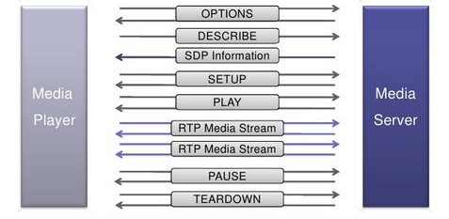
Methods
Record
Set_Parameter
Notes:
Options: This request determines what other types of requests the media server will accept.
Describe: A describe request identifies the URL and type of data.
Announce: The announce method describes the presentation when sent from the client to the server and updates the description when sent from server to client.
Setup: Setup requests specify how a media stream must be transported before a play request is sent.
Play: A play request starts the media transmission by telling the server to start sending the data.
Pause: Pause requests temporarily halt the stream delivery.
Record: A record request initiates a media recording.
Teardown: This request terminates the session entirely and stops all media streams.
Set_Parameter. Set_Parameter can test whether the client or server is active

Slide 10


Security
Authorized users only
Secured!

Slide 11
Camera RTSP Authentication
Basic authentication
Digest authentication
TLS/SSL encryption
IP address restriction
Send Security code

